Slide 1

Job Skill Demand — Trend Analysis & Forecasting
Dataset: Kaggle LinkedIn Job Postings
Author: Kirti Gupta
Date: August 2025
Course: Minor in AI
Notes:
1

Slide 2
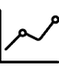


ABSTRACT & PROBLEM STATEMENT
Forecast Demand
Identify Trends
Deliverables
Short-horizon demand for top job skills (daily postings).
Helps pinpoint rising or falling job market trends.
Metrics CSVs, forecast CSVs, plots, and classification reports.
This project aims to provide data scientists and ML practitioners with a robust framework for forecasting job skill demand, offering crucial insights into the evolving labor market.
Notes:
2

Slide 3

DATASET OVERVIEW
Our analysis leverages a comprehensive dataset sourced from Kaggle: LinkedIn Job Postings.
Size: Approximately 124,000 rows of job posting data.
Tables: Includes postings.csv, job_skills.csv, and a skills.csv mapping for granular skill associations.
Skills: Features around 35 unique skills post-preprocessing, ensuring focus on relevant and actionable insights.
Timeframe: Covers job market activity from 2024 to 2025, providing recent trend data.
Notes:
3

Slide 4

DATA CLEANING & SALARY HARMONIZATION
01
DEDUPLICATION
Eliminated duplicate job postings based on unique job_id to ensure data integrity.
02
MISSING DATA IMPUTATION
Systematically filled in missing categorical fields to complete records.
03
SALARY STANDARDIZATION
Converted all varied salary formats (hourly, weekly, monthly) into a standardized annual USD equivalent.
04
OUTLIER TREATMENT
Clipped extreme outliers and applied log1p transformations to address skewed salary distributions, improving model performance.
Notes:
4

Slide 5
EXPLORATORY DATA ANALYSIS (EDA)
Our EDA focused on identifying key data characteristics and potential challenges:
Null Value Check : Significant missingness observed in salaries and skills_desc fields, requiring careful handling.
Top Posting Locations : Identified major job hubs including New York, Chicago, Houston, and Dallas, indicating key market centers.
Salary Distribution : Analyzed annual salary distribution on a log scale to understand compensation trends.
Notes:
5

Slide 6
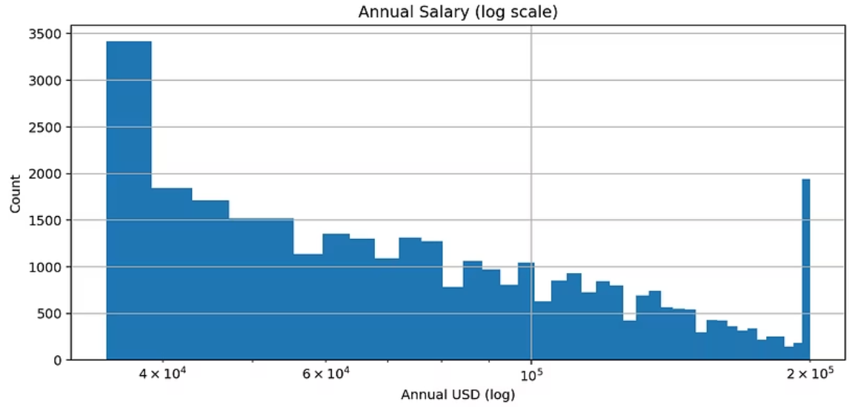
ANNUAL SALARY DISTRIBUTION
The histogram shows the distribution of annualized salaries across postings. A log scale is applied to handle extreme values and highlight the concentration of salaries in the mid-range (40K–120K USD).

Slide 7
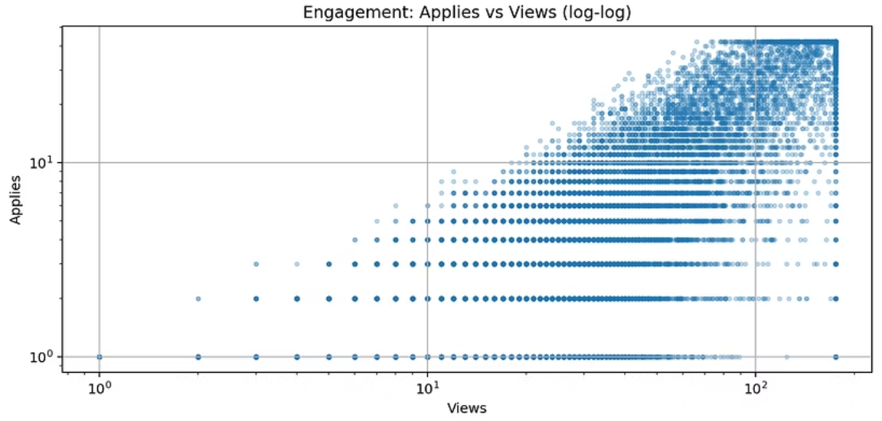
ENGAGEMENT: VIEWS VS APPLIES
Scatter plot (log-log scale) comparing the number of job posting views against applications. Most postings cluster at low engagement, while a few outliers receive disproportionately high views and applies.

Slide 8
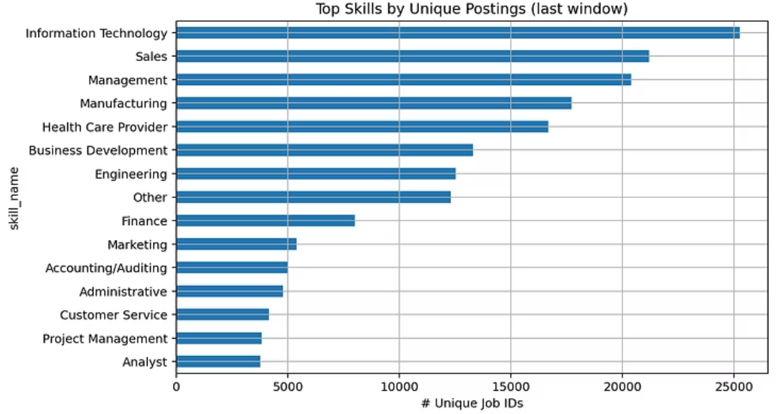
TOP 15 SKILLS BY UNIQUE JOB POSTINGS
Horizontal bar chart of the most frequently requested skills in job postings. Skills like Information Technology, Sales, Management, and Engineering dominate demand.

Slide 9


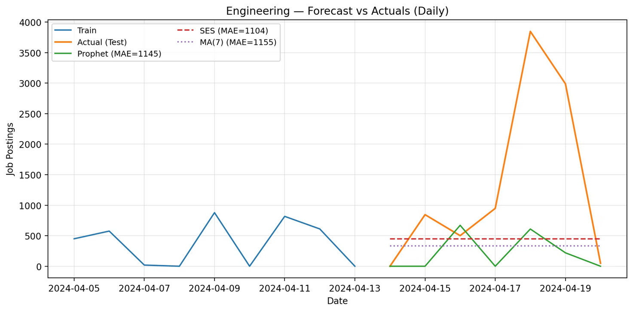
BASELINE FORECASTING MODELS
To establish a performance benchmark, we implemented several baseline forecasting models:
Naive Model
MA(7) Model
SES Model
Utilizes the last observed value as the forecast.
A 7-day moving average, smoothing out daily fluctuations.
Simple Exponential Smoothing, suitable for data with no trend or seasonality.
Performance was evaluated using standard metrics:
Metrics: Mean Absolute Error (MAE), Root Mean Squared Error (RMSE), Symmetric Mean Absolute Percentage Error (sMAPE).
Example: For the "Legal" skill, SES yielded an MAE of 174.
Summary: A comprehensive table summarizes baseline performance for top skills.
Notes:
6

Slide 10
ADVANCED BASELINES
(ROLLING CROSS-VALIDATION)
To further refine our forecasting capabilities, we adopted rolling cross-validation with more sophisticated models:
Models: Adaptive CV with ARIMA, SES, Naive, and MA(7) models, dynamically adjusting to time-series characteristics.
Windows: Utilized both daily and weekly windows, with forecasting horizons ranging from 3 to 7 days, capturing short-term variability.
Example: For "Health Care Provider" skill, SES demonstrated superior performance with an MAE of 1194.
Results: An excerpt from the adaptive results table highlights key performance metrics.
Notes:
7

Slide 11
PROPHET FORECASTING
"Prophet, developed by Facebook, is designed for forecasting time series data based on an additive model where non-linear trends are fit with yearly, weekly, and daily seasonality, plus holiday effects."
We applied Facebook's Prophet model for its robustness with time series data, especially for daily patterns:
Core Skills: Forecasts were tailored for essential skills such as Writing/Editing, QA, Accounting, Engineering, and IT.
Metrics: Daily MAE, RMSE, sMAPE, and Mean Absolute Scaled Error (MASE) were computed to assess accuracy.
Comparison: Notably, SES proved competitive with Prophet for skills with shorter historical data, indicating its efficiency in specific scenarios.
Detailed daily metrics and forecast plots are available for review.
Notes:
8

Slide 12
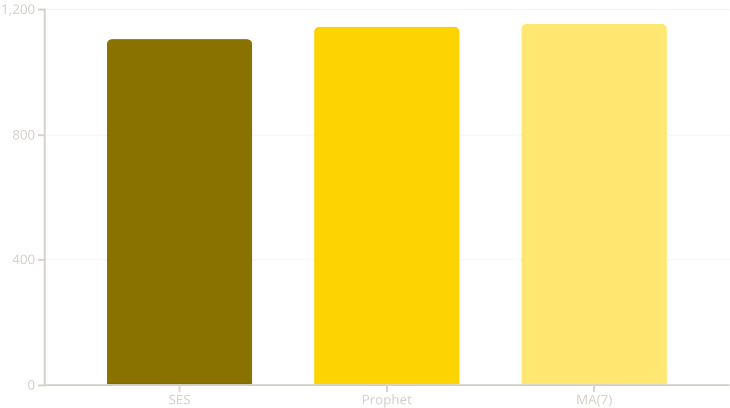
ENGINEERING SKILL : MODEL COMPARISON
A focused comparison of forecasting models for the "Engineering" skill reveals nuanced performance differences:
Models Compared: Prophet, SES, and MA(7) models.
Results (MAE): SES (1104) slightly outperformed Prophet (1145) and MA(7) (1155).
Conclusion: While all models performed strongly, SES demonstrated marginal superiority for this specific skill.
A polished forecast vs. actuals plot vividly illustrates model performance against real-world data.
Notes:
9

Slide 13

CLASSIFICATION TASK (TREND UP VS NOT-UP)
Beyond forecasting, we explored classifying skill demand trends:
Features: Engineered features included rolling means, differences, z-scores, and lagged values to capture trend dynamics.
Model: Logistic Regression was employed, with careful threshold tuning for optimal classification.
Robustness: Implemented walk-forward cross-validation with fallback for small sample sizes, ensuring model stability.
Example: For "Engineering," the model achieved an accuracy of ~0.67 and an MCC of 0.45, indicating reasonable performance in identifying upward trends.
Key Takeaway
This classification model provides a valuable tool for early identification of emerging or declining job skill demands, crucial for strategic workforce planning.
Notes:
10

Slide 14




KEY PROJECT ARTIFACTS & DELIVERABLES
Throughout this project, a comprehensive set of artifacts has been generated to document our findings and methodologies. These deliverables provide actionable insights and the underlying data for further analysis:
Data & EDA Insights
Baseline Model Performance
Salary Distribution Histogram
metrics_multi_skill_D.csv (Detailed metrics)
Applications vs. Views Scatter Plot
advanced_adaptive_results.csv (Adaptive CV results)
Top Skills Bar Chart
Advanced Forecasting Outputs
Classification Task Outputs
Prophet: Daily & Weekly Metrics
results.jsonl (Model performance)
Prophet: Comprehensive Forecast Plots
predictions.csv (Predicted trends)
Engineering: Model Comparison CSV
holdout_probs.png (Probability visualization)
Engineering: Forecast Plots
Notes:
11

Slide 15
CONCLUSION & FUTURE WORK
SES often rivals Prophet on short histories
Classification feasible but data-limited
Future: weekly aggregation, external features, pooled models
All artifacts reproducible via notebook
Notes:
12

